Slide 1



3130704
Digital Fundamentals
Module 2:
Combinational Digital Circuits
Prof. Krunal D. Vyas
9601901005
krunal.vyas@darshan.ac.in

Slide 2
Topics to be covered
Standard representation for logic functions
Simplification using K-Map
Multiplexer/De-multiplexer, Decoder
Adders, Subtractors
Combinational Circuits
Q-M Method

Slide 3

Boolean functions & representation
Sum-of-products (SOP) form (Disjunctive Normal Form)
$$f(A,B,C)=(A\overline{B}+\overline{B}C)$$
Products-of-sums (POS) form (Conjunctive Normal Form)
$$f(A,B,C)=(\overline{A}+\overline{B})(B+C)$$

Slide 4

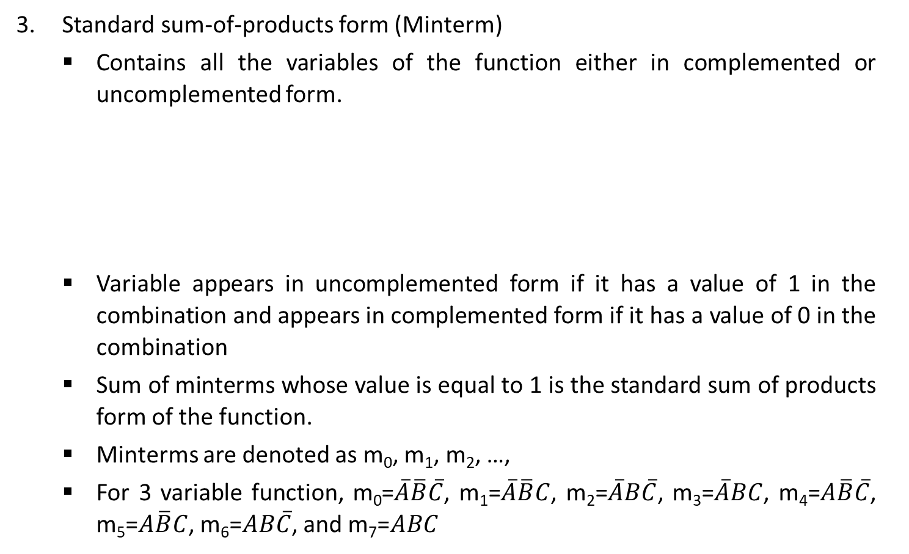


Boolean functions & representation
Standard sum-of-products form (Minterm)
Contains all the variables of the function either in complemented or uncomplemented form.
Variable appears in uncomplemented form if it has a value of 1 in the combination and appears in complemented form if it has a value of 0 in the combination
Sum of minterms whose value is equal to 1 is the standard sum of products form of the function.
Minterms are denoted as m₀, m₁, m₂, …,
For 3 variable function, m₀=$\overline{A}\overline{B}\overline{C}$, m₁=$\overline{A}\overline{B}C$, m₂=$\overline{A}B\overline{C}$, m₃=$\overline{A}BC$, m₄=$A\overline{B}\overline{C}$, m₅=$A\overline{B}C$, m₆=$AB\overline{C}$, and m₇=$ABC$
$$f\left(A,B,C\right)=\overline{A}B+\overline{B}C$$
$$=\overline{A}B\left(C+\overline{C}\right)+\overline{B}C\left(A+\overline{A}\right)$$
$$=\overline{A}BC+\overline{A}B\overline{C}+A\overline{B}C+\overline{A}\overline{B}C$$
Minterm: Value of Minterm = 1

Slide 5

Boolean functions & representation
Standard sum-of-products form (Minterm)
Canonical SOP form is shown by the sum of minterms for which the function equals 1.
f(A,B,C) = m₁ + m₂ + m₃ + m₅
Or
f(A,B,C) = $\sum_{m}{(1,2,3,5)}$

Slide 6


Boolean functions & representation
Standard product-of-sum form (Maxterm)
Derived by considering the combinations of which f = 0
Each term is a sum of all the variables
Variable appears in uncomplemented form if it has a value of 0 in the combination and appears in complemented form if it has a value of 1 in the combination
$$f\left(A,B,C\right)=(\overline{A}+\overline{B})(A+B)$$
$$= (\overline{A}+\overline{B}+C\overline{C})(A+B+C\overline{C})$$
$$= (\overline{A}+\overline{B}+C)(\overline{A}+\overline{B}+\overline{C})(A+B+C)(A+B+\overline{C})$$
Maxterm: Value of Maxterm = 0

Slide 7
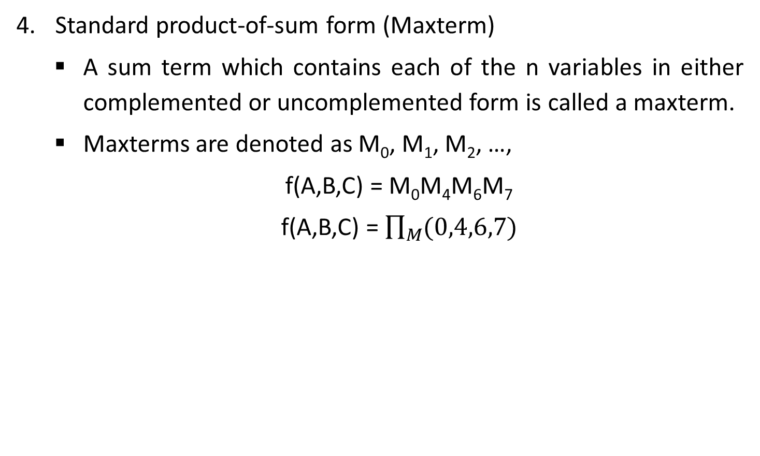
Boolean functions & representation
Standard product-of-sum form (Maxterm)
A sum term which contains each of the n variables in either complemented or uncomplemented form is called a maxterm.
Maxterms are denoted as M₀, M₁, M₂, …,
f(A,B,C) = M₀M₄M₆M₇
f(A,B,C) = $\prod_{M}{(0,4,6,7)}$

Slide 8
Introduction to K-Maps
Simplification of Boolean functions leads to simpler (and usually faster) digital circuits.
Simplifying Boolean functions using identities is time-consuming and error-prone.
This special section presents an easy, systematic method for reducing Boolean expressions.

Slide 9
Karnaugh Maps (K-Maps)
A K-Map is a matrix consisting of rows and columns that represent the output values of a Boolean function.
The output values placed in each cell are derived from the minterms of a Boolean function.
A minterm is a product term that contains all of the function’s variables exactly once, either complemented or not complemented.

Slide 10
2 – Variable K-Map
The two variables A and B have four possible combinations that can be represented by the map as follows
A
0
1
B
A | B | Minterm
0 | 0 | m₀ = A’B’
0 | 1 | m₁ = A’B
1 | 0 | m₂ = AB’
1 | 1 | m₃ = AB
0
2
0
1
3
1

Slide 11
3 – Variable K-Map
The three variables A, B and C have eight possible combinations that can be represented by the map as follows
A | B | C | Minterm
0 | 0 | 0 | m₀ = A’B’C’
0 | 0 | 1 | m₁ = A’B’C
0 | 1 | 0 | m₂ = A’BC’
0 | 1 | 1 | m₃ = A’BC
1 | 0 | 0 | m₄ = AB’C’
1 | 0 | 1 | m₅ = AB’C
1 | 1 | 0 | m₆ = ABC’
1 | 1 | 1 | m₇ = ABC
AB
00
01
11
10
C
0
2
6
4
0
1
3
7
5
1
Minterm Number

Slide 12
4 – Variable K-Map
The four variables A, B, C and D have sixteen possible combinations that can be represented by the map as follows
A | B | C | D | Minterm
0 | 0 | 0 | 0 | m₀ = A’B’C’D’
0 | 0 | 0 | 1 | m₁ = A’B’C’D
0 | 0 | 1 | 0 | m₂ = A’B’CD’
0 | 0 | 1 | 1 | m₃ = A’B’CD
0 | 1 | 0 | 0 | m₄ = A’BC’D’
0 | 1 | 0 | 1 | m₅ = A’BC’D
0 | 1 | 1 | 0 | m₆ = A’BCD’
0 | 1 | 1 | 1 | m₇ = A’BCD
A | B | C | D | Minterm
1 | 0 | 0 | 0 | m₈ = AB’C’D’
1 | 0 | 0 | 1 | m₉ = AB’C’D
1 | 0 | 1 | 0 | m₁₀ = AB’CD’
1 | 0 | 1 | 1 | m₁₁ = AB’CD
1 | 1 | 0 | 0 | m₁₂ = ABC’D’
1 | 1 | 0 | 1 | m₁₃ = ABC’D
1 | 1 | 1 | 0 | m₁₄ = ABCD’
1 | 1 | 1 | 1 | m₁₅ = ABCD

Slide 13
4 – Variable K-Map
AB
00
01
11
10
CD
0
4
12
8
00
1
5
13
9
01
3
7
15
11
11
2
6
14
10
10

Slide 14
Function plotting in K-Map
Consider function
F = AB + A’B
A
0
1
B
0
2
0
0
0
1
3
1
1
1

Slide 15

Reduce Boolean Expression
Consider the function:
$$f\left(A,B,C\right)=A^{′}B^{′}C+A^{′}BC+AB^{′}C+ABC$$
Its K-Map is given below.
What is the largest group of 1’s that is a power of 2?
AB
00
01
11
10
C
0
2
6
4
0
1
3
7
5
1
1
1
1
1

Slide 16

Reduce Boolean Expression
This grouping tells us that changes in the variables A and B have no influence upon the value of the function: They are irrelevant.
This means that the function,
$$f\left(A,B,C\right)=A^{′}B^{′}C+A^{′}BC+AB^{′}C+ABC$$
reduces to $f\left(A,B,C\right)=C$
AB
00
01
11
10
C
0
2
6
4
0
1
3
7
5
1
1
1
1
1

Slide 17



Examples
$$f=AB^{′}C+A^{′}B′C$$
$$f=ABC′D+ABCD+A^{′}BC^{′}D+A^{′}BCD$$
AB
AB
00
01
11
10
00
01
11
10
C
CD
0
4
12
8
0
00
1
5
13
9
1
1
01
1
1
1
3
7
15
11
$$f=B^{′}C$$
11
1
1
2
6
14
10
10
$$f=BD$$

Slide 18


Examples
$$f=ABC^{′}D+AB^{′}C^{′}D^{′}+AB^{′}CD^{′}+A^{′}B^{′}CD^{′}+A^{′}B^{′}C^{′}D′$$
AB
00
01
11
10
CD
0
4
12
8
00
1
1
1
5
13
9
01
1
3
7
15
11
11
2
6
14
10
10
1
1
$$f=ABC^{′}D$$
$${+ B}^{′}D^{′}$$

Slide 19



Examples
$$f=A^{′}BC^{′}D+A^{′}B^{′}C^{′}D+A^{′}B^{′}C^{′}D′$$
AB
00
01
11
10
CD
0
4
12
8
00
1
1
5
13
9
01
1
1
3
7
15
11
11
2
6
14
10
10
$$f=A^{′}B^{′}C^{′}$$
$$+ A^{′}C^{′}D$$

Slide 20

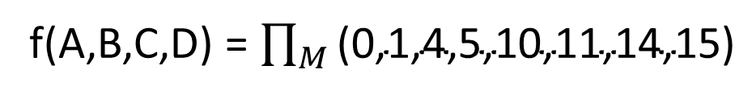

Examples
f(A,B,C,D) = $\prod_{M}{\text{(0,1,4,5,10,11,14,15)}}$
AB
00
01
11
10
CD
0
4
12
8
00
0
0
$$f=(A+C)$$
$$(A^{′}+C^{′})$$
1
5
13
9
01
0
0
3
7
15
11
11
0
0
2
6
0
14
0
10
10

Slide 21
Don’t care conditions
Suppose we are given a problem of implementing a circuit to generate a logical 1 when a 2, 7, or 15 appears on a four-variable input.
A logical 0 should be generated when 0, 1, 4, 5, 6, 9, 10, 13 or 14 appears.
The input conditions for the numbers 3, 8, 11 and 12 never occur in the system. This means we don’t care whether inputs generate logical 1 or logical 0.
Don’t care combinations are denoted by ‘x’ in K-Map which can be used for the making groups.
The above example can be represented as

Slide 22


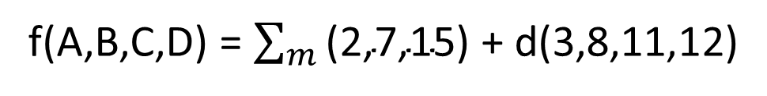
Examples
f(A,B,C,D) = $\sum_{m}{\text{(2,7,15)}}$ + d(3,8,11,12)
AB
00
01
11
10
CD
0
4
12
8
00
x
x
1
5
13
9
01
3
7
15
11
11
x
1
1
x
2
6
14
10
10
1
$$f=CD$$
$$+ A^{′}B^{′}C$$

Slide 23


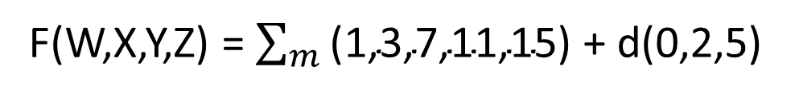
Examples
F(W,X,Y,Z) = $\sum_{m}{\text{(}\text{1}\text{,}\text{3}\text{,}\text{7,11,15}\text{)}}$ + d(0,2,5)
WX
00
01
11
10
YZ
0
4
12
8
00
x
1
5
13
9
01
1
x
3
7
15
11
11
1
1
1
1
2
6
14
10
10
x
$$f=W^{′}X′$$
$$+YZ$$

Slide 24
Variable-Entered Maps
Variable-entered map can be used to plot an n-variable problem on n – 1 variable map
Possible to reduce the map dimension by two or three in some cases
Advantage of using VEM occurs in design problems involving multiplexers

Slide 25
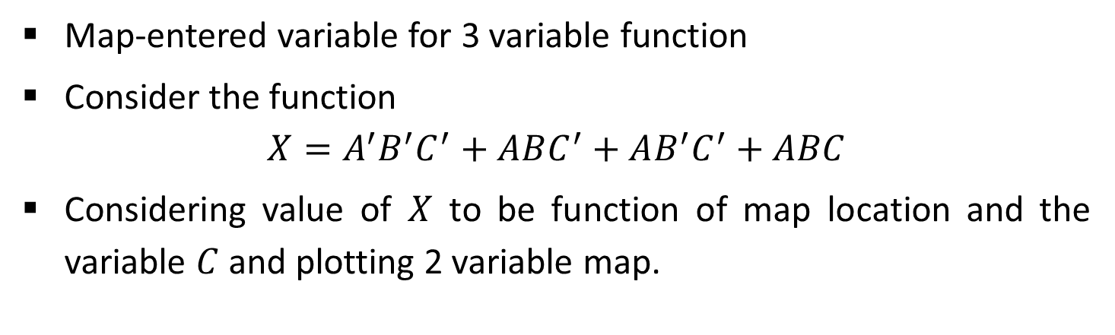
Plotting Variable-Entered Map
Map-entered variable for 3 variable function
Consider the function
$$X=A^{′}B^{′}C^{′}+ABC^{′}+AB^{′}C^{′}+ABC$$
Considering value of $X$ to be function of map location and the variable $C$ and plotting 2 variable map.
A
A
0
1
0
1
B
B
X=1 if C’=1
X=1 if C’=1
0
0
C’
C’
X=1 if C’=1 or if C = 1
1
X=0
1
0
C + C’

Slide 26
Reducing Expressions with VEM
Choose groups of similar terms to cover all nonzero terms appearing in the map except “don’t care” terms.
Rest complete process is similar to K-Map

Slide 27



Reducing Expressions with VEM
$$f=AB^{′}CD+A^{′}BC^{′}D+AB^{′}CD^{′}+ABC^{′}D+A^{′}B^{′}C^{′}D$$
AB
00
01
11
10
C
0
D
D
D
D
1
D+D’
$$f=A^{′}C^{′}D$$
$$+ BC′D$$
$$+ AB^{′}C$$

Slide 28





Reducing Expressions with VEM
$$f=A^{′}B^{′}C^{′}D+A^{′}BC^{′}D^{′}+A^{′}BC^{′}D+AB^{′}C^{′}D′+AB^{′}CD^{′}+AB^{′}CD+ABCD′$$
AB
00
01
11
10
C
D
D’
D’
0
D+D’
D’
D’
1
D+D’
$$f=A^{′}C^{′}D$$
$$+ A^{′}BC′$$
$$+ ACD′$$
$$+ AB′D′$$
$$+ AB^{′}C$$

Slide 29




Reducing Expressions with VEM
$$f=A^{′}B^{′}C^{′}D^{′}E+A^{′}B^{′}C^{′}DE+A^{′}BCD^{′}E^{′}+A^{′}BCD^{′}E+AB^{′}C^{′}D^{′}E^{′}$$
$$+ AB^{′}C^{′}D^{′}E+AB^{′}C^{′}D+A^{′}BCDE′$$
AB
00
01
11
10
CD
E
E+E’
00
E’
$$f=B^{′}C^{′}E$$
$$+ AB^{′}C′$$
$$+ A^{′}BCD^{′}$$
$$+ A^{′}BCE′$$
01
E
E+E’
11
E’
E+E’
10
E’

Slide 30
Realizing Logic Function with Gates
Implement AB’ + C’D using AND, OR & Invert Gates
A
B
C
D

Slide 31
Converting AND/OR/Invert Logic to NAND/NOR Logic
Draw the circuit in AOI logic.
If NAND hardware is chosen, add a circle at the output of each AND gate and at the inputs to all the OR gates.
If NOR hardware is chosen, add a circle at the output of each OR gate and at the inputs to all the AND gates.
Add or subtract an inverter on each line that received a circle in steps 2 or 3 so that the polarity of signals on those lines remains unchanged from that of the original diagram.
Replace bubbled OR by NAND and bubbled AND by NOR.
Eliminate double inversions.

Slide 32
Converting AND/OR/Invert Logic to NAND/NOR Logic
Implement the following AOI logic using a) NAND logic and b) NOR logic

Slide 33
Converting AND/OR/Invert Logic to NAND/NOR Logic
a) NAND logic
Put a circle at the output of each AND gate and at the inputs to all OR gates

Slide 34
Converting AND/OR/Invert Logic to NAND/NOR Logic
a) NAND logic
Add an inverter to each of the lines that received only one circle at input so that polarity remains unchanged.

Slide 35
Converting AND/OR/Invert Logic to NAND/NOR Logic
a) NAND logic
Replace bubbled OR gates and NOT gates by NAND gates.

Slide 36
Multiplexer
A multiplexer(MUX) is a device that allows digital information from several sources to be routed onto a single line for transmission over that line to a common destination.
Consider an integer ‘m’, which is constrained by the following relation:
m = 2^{n}, where m and n are both integers.
A m-to-1 Multiplexer has
m Inputs: I₀, I₁, I₂, ................ I_{(m-1)}
One Output: Y
n Control inputs: S₀, S₁, S₂, ...... S_{(n-1)}
One (or more) Enable input(s)
Such that Y may be equal to one of the inputs, depending upon the control inputs.

Slide 37
4-to-1 Multiplexer
2^{n} inputs
Select Inputs |  | Output
S₁ | S₀ | Y
0 | 0 | I₀
0 | 1 | I₁
1 | 0 | I₂
1 | 1 | I₃
I₀
I₁
I₀
4 x 1 MUX
Y
I₂
1 output
I₃
Enable (G)
Y = S₁’S₀’I₀ + S₁’S₀I₁ + S₁S₀’I₂ + S₁S₀I₃
S₁
S₀
0
0
n control inputs

Slide 38
4 x 1 MUX Actual Circuit
I₃
I₂
Y
I₁
I₀
S₁
S₀
Enable (G)

Slide 39
Application of Multiplexer
Logic function generation
Data selection
Data routing
Operation sequencing
Parallel-to-serial conversion
Waveform generation

Slide 40
Logic function generator
Implement the following function using 8 to 1 MUX
F(x,y,z) = Σ m(0,2,3,5)
S₂ | S₁ | S₀ | F
x | y | z
0 | 0 | 0 | 1
0 | 0 | 1 | 0
0 | 1 | 0 | 1
0 | 1 | 1 | 1
1 | 0 | 0 | 0
1 | 0 | 1 | 1
1 | 1 | 0 | 0
1 | 1 | 1 | 0
z
S₀
y
S₁
x
S₂
1
D₀
0
D₁
8 x 1 MUX
Output = F
1
D₂
1
D₃
0
D₄
1
D₅
0
D₆
0
D₇

Slide 41
Logic function generator
Multiplexer with n-data select inputs can implement any function of n + 1 variables.
The first n variables of the function as the select inputs and to use the least significant input variable and its complement to drive some of the data inputs.
If the single variable is denoted by D, each data output of the multiplexer will be D, D’, 1, or 0.
Suppose, we wish to implement a 4-variable logic function using a multiplexer with three data select inputs.
Let the input variables be A, B, C, and D; D is the LSB.

Slide 42
Logic function generator
A truth table for the function F(A, B, C, D) is constructed with ABC has the same value twice once with D = 0 and again with D = 1.
The following rules are used to determine the connections that should be made to the data inputs of the multiplexer.
If F = 0 both times when the same combination of ABC occurs, connect logic 0 to the data input selected by that combination.
If F = 1 both times when the same combination of ABC occurs, connect logic 1 to the data input selected by that combination.
If F is different for the two occurrences of a combination of ABC, and if F = D in each case, connect D to the data input selected by that combination.
If F is different for the two occurrences of a combination of ABC, and if F = D in each case, connect D to the data input selected by that combination.

Slide 43
Implement the following function using 8 to 1 MUX F = Σ m(0,1,2,3,4,10,11,14,15)
S₂ | S₁ | S₀ | D | F
A | B | C
0 0 | 0 0 | 0 0 | 0 1 | 1 1 | F = 1
0 0 | 0 0 | 1 1 | 0 1 | 1 1 | F = 1
0 0 | 1 1 | 0 0 | 0 1 | 1 0 | F = D’
0 0 | 1 1 | 1 1 | 0 1 | 0 0 | F = 0
1 1 | 0 0 | 0 0 | 0 1 | 0 0 | F = 0
1 1 | 0 0 | 1 1 | 0 1 | 1 1 | F = 1
1 1 | 1 1 | 0 0 | 0 1 | 0 0 | F = 0
1 1 | 1 1 | 1 1 | 0 1 | 1 1 | F = 1
C
S₀
B
S₁
A
S₂
1
D₀
1
D₁
8 x 1 MUX
Output = F
D’
D₂
0
D₃
0
D₄
1
D₅
0
D₆
1
D₇

Slide 44
Demultiplexer
A demultiplexer(DEMUX) is a device that allows digital information from one source to be routed onto a multiple lines for transmission over different destinations.
Consider an integer ‘m’, which is constrained by the following relation:
m = 2^{n}, where m and n are both integers.
A 1-to-m Demultiplexer has
One Input: D
m Outputs: O₀, O₁, O₂, ................ O_{(m-1)}
n Control inputs: S₀, S₁, S₂, ...... S_{(n-1)}
One (or more) Enable input(s)
Such that D may be transfer to one of the outputs, depending upon the control inputs.

Slide 45
1-to-4 Demultiplexer
O₀
Select code |  | Outputs
S₁ | S₀ | O₃ | O₂ | O₁ | O₀
0 | 0 | 0 | 0 | 0 | D
0 | 1 | 0 | 0 | D | 0
1 | 0 | 0 | D | 0 | 0
1 | 1 | D | 0 | 0 | 0
O₁
1x4 DEMUX
D
O₂
O₃
S₁
S₀

Slide 46
1-to-4 Demultiplexer
D
S₁
S₁’
S₀
S₀’
O₀ = D S ₁’ S₀’
O₁ = D S ₁’ S₀
O₂ = D S ₁ S₀’
O₃ = D S ₁ S₀

Slide 47
Decoder
A decoder is a logic circuit that accepts a set of inputs which represents a binary number and activates the only output that corresponds to the input number.
In other words, a decoder circuit looks at its inputs, determines which binary number is present there, and activates the specific output which corresponds to that number; all other outputs remain inactive.

Slide 48
Decoder
In its general form, a decoder has N input lines to handle N bits and M output lines such that only one output line is activated for each one of the possible combinations of inputs.
I₀
O₀
I₁
O₁
I₂
O₂
.
.
.
.
.
.
N inputs
Decoder
M outputs
I_{N-2}
O_{M-2}
I_{N-1}
O_{M-1}
M = 2^{N}

Slide 49
3-Line to 8-Line Decoder
3 to 8 line decoder can be implemented using AND gates to achieve active-HIGH output.
For active-LOW outputs, NAND gates are used.

Slide 50
3-Line to 8-Line Decoder
Truth Table
Inputs |  |  | Outputs
A | B | C | D₀ A’B’C’ | D₁ A’B’C | D₂ A’BC’ | D₃ A’BC | D₄ AB’C’ | D₅ AB’C | D₆ ABC’ | D₇ ABC
0 | 0 | 0 | 1 | 0 | 0 | 0 | 0 | 0 | 0 | 0
0 | 0 | 1 | 0 | 1 | 0 | 0 | 0 | 0 | 0 | 0
0 | 1 | 0 | 0 | 0 | 1 | 0 | 0 | 0 | 0 | 0
0 | 1 | 1 | 0 | 0 | 0 | 1 | 0 | 0 | 0 | 0
1 | 0 | 0 | 0 | 0 | 0 | 0 | 1 | 0 | 0 | 0
1 | 0 | 1 | 0 | 0 | 0 | 0 | 0 | 1 | 0 | 0
1 | 1 | 0 | 0 | 0 | 0 | 0 | 0 | 0 | 1 | 0
1 | 1 | 1 | 0 | 0 | 0 | 0 | 0 | 0 | 0 | 1

Slide 51
A
A’
B
B’
C
C’
D₇ = ABC
D₆ = ABC’
D₅ = AB’C
D₄ = AB’C’
D₃ = A’BC
D₂ = A’BC’
D₁ = A’B’C
D₀ = A’B’C’

Slide 52
Half Adder
A combinational circuit which adds two one-bit binary numbers is called a half-adder.
The sum column resembles like an output of the XOR gate.
The carry column resembles like an output of the AND gate.
Inputs |  | Outputs
A | B | Sum | Carry
0 | 0 | 0 | 0
0 | 1 | 1 | 0
1 | 0 | 1 | 0
1 | 1 | 0 | 1
A
S = A ⊕ B
B
C = AB

Slide 53
Limitation of Half-Adder
In multi-digit addition we have to add two bits along with the carry of previous digit addition. Such addition requires addition of 3 bits. This is not possible in half-adders.

Slide 54
Full Adder
In a full adder, three bits can be added at a time. The third bit is a carry from a less significant column.
Inputs |  |  | Outputs
A | B | C_{in} | S | C_{out}
0 | 0 | 0 | 0 | 0
0 | 0 | 1 | 1 | 0
0 | 1 | 0 | 1 | 0
0 | 1 | 1 | 0 | 1
1 | 0 | 0 | 1 | 0
1 | 0 | 1 | 0 | 1
1 | 1 | 0 | 0 | 1
1 | 1 | 1 | 1 | 1
S = A’B’C_{in} + A’BC_{in}’ + AB’C_{in}’ + ABC_{in}
= (AB’ + A’B)C_{in}’ + (AB + A’B’)C_{in}
= (A ⊕ B)C_{in}’ + (A ⊕ B)’C_{in}
= A ⊕ B ⊕ C_{in}
C_{out} = A’BC_{in} + AB’C_{in} + ABC_{in}’ + ABC_{in}
= AB + (A ⊕ B)C_{in}

Slide 55
Full Adder
S = A ⊕ B ⊕ C_{in}
Logic diagram for full adder
C_{out} = AB + (A ⊕ B)C_{in}
A
S = A ⊕ B ⊕ C_{in}
B
C_{in}
C_{out} = AB + (A ⊕ B)C_{in}
Half Adder
Half Adder

Slide 56
Half Subtractor
Subtracts one bit from the other and produces the difference.
Other output is to specify if 1 is borrowed
A
d = A ⊕ B
Inputs |  | Outputs
A | B | d | b
0 | 0 | 0 | 0
0 | 1 | 1 | 1
1 | 0 | 1 | 0
1 | 1 | 0 | 0
B
b = A’B

Slide 57
Full Subtractor
Half subtractor can be used only for LSB subtraction.
Borrow from LSBs affects the subtraction in the next higher column.
Subtrahend bit is subtracted from minuend and consider borrow if generated from preceding column.
Full subtractor is a combinational circuit with 3 inputs (A, B, b_{i})
Subtraction = A – B – b_{i}

Slide 58
Full Subtractor
Inputs |  |  | Outputs
A | B | b_{i} | d | b
0 | 0 | 0 | 0 | 0
0 | 0 | 1 | 1 | 1
0 | 1 | 0 | 1 | 1
0 | 1 | 1 | 0 | 1
1 | 0 | 0 | 1 | 0
1 | 0 | 1 | 0 | 0
1 | 1 | 0 | 0 | 0
1 | 1 | 1 | 1 | 1
d = A’B’b_{i} + A’Bb_{i}’ + AB’b_{i}’ + ABb_{i}
= (AB’ + A’B)b_{i}’ + (AB + A’B’)b_{i}
= (A ⊕ B)b_{i}’ + (A ⊕ B)’b_{i}
= A ⊕ B ⊕ b_{i}
b = A’B’b_{i} + A’Bb_{i}’ + A’Bb_{i} + ABb_{i}
= A’B(b_{i} + b_{i}’) + (AB + A’B’)b_{i}
= A’B + (A ⊕ B)’b_{i}

Slide 59
Full Subtractor
d = A ⊕ B ⊕ b_{i}
b = A’B + (A ⊕ B)’b_{i}
A
d = A ⊕ B ⊕ b_{i}
B
b = A’B + (A ⊕ B)’b_{i}
b_{i}

Slide 60
Binary Parallel Adder
B₄
A₄
B₃
A₃
B₂
A₂
B₁
A₁
C₃
C₂
C₁
FA₄
FA₃
FA₂
FA₁
C_{in}
C₄
S₄
S₃
S₂
S₁

Slide 61
Binary Parallel Subtractor
B₄
A₄
B₃
A₃
B₂
A₂
B₁
A₁
C₃
C₂
C₁
C_{in}= 1
FA₄
FA₃
FA₂
FA₁
C_{out}
S₄
S₃
S₂
S₁

Slide 62
Binary Adder-Subtractor
B₄
A₄
B₃
A₃
B₂
A₂
B₁
A₁
M
C₃
C₂
C₁
C_{in}
FA₄
FA₃
FA₂
FA₁
C₄
S₄
S₃
S₂
S₁
When M = 0, Circuit is an adder.
When M = 1, Circuit becomes a subtractor.

Slide 63
Look Ahead Carry Adder
Speeds up the process by eliminating the ripple carry delay.
The method of speeding up the addition process is based on: carry generate and carry propagate functions.
Consider one full adder stage; say the nth stage of a parallel adder shown in below Figure.
A_{n} B_{n} = G_{n}
C_{n+1} = (A_{n} ⊕ B_{n}) C_{n} + A_{n} B_{n}
A_{n}
HA
A_{n} ⊕ B_{n} = P_{n}
P_{n} C_{n} = C₀
B_{n}
HA
S_{n} = A_{n} ⊕ B_{n} ⊕ C_{n}
C_{n}

Slide 64
Look Ahead Carry Adder
S_{n} = P_{n} ⊕ C_{n} where P_{n} = A_{n} ⊕ B_{n}
C_{n+1} = G_{n} + P_{n} C_{n} where G_{n} = A_{n} B_{n}
Possible to express the output carry of a higher significant stage in terms of applied input variables A, B and carry-in to the LSB adder.
Based on these, the expression for the carry-outs of various full adders are as follows:
C₂ = G₁ + P₁ C₁
C₃ = G₂ + P₂ C₂
= G₂ + P₂ (G₁ + P₁ C₁)
= G₂ + P₂ G₁ + P₂ P₁ C₁
C₄ = G₃ + P₃ C₃ = G₃ + P₃ G₂ + P₃ P₂ G₁ + P₃ P₂ P₁ C₁
C₅ = G₄ + P₄ C₄ = G₄ + P₄ G₃ + P₄ P₃ G₂ + P₄ P₃ P₂ G₁ + P₄ P₃ P₂ P₁ C₁

Slide 65
B₄
A₄
P₄
C₅
C₅
P₄
S₄
G₄
C₄
B₃
A₃
P₃
P₃
S₃
G₃
C₃
Look ahead carry generator
B₂
A₂
P₂
G₂
P₂
S₂
C₂
B₁
A₁
P₁
P₁
S₁
G₁
C₁
C₁

Slide 66
Serial Adder
SI
Shift
control
SO
Shift register A
CLK
x
S
y
FA
C
SI
Serial
input
z
SO
Shift register B
Q
D
C
Clear

Slide 67
Arithmetic Logic Unit (ALU)
A
B
A₄
A₃
A₂
A₁
B₄
B₃
B₂
B₁
S₂
(Mode - select)
S₁
C_{out}
Arithmetic Logic Unit (ALU)
(Function - select)
(Output carry)
S₀
C_{in}
(Input carry)
F₄
F₃
F₂
F₁
F

Slide 68
Arithmetic Logic Unit (ALU)
Selection |  |  |  | Output | Function
S₂ | S₁ | S₀ | C_{in}
0 | 0 | 0 | 0 | F = A | Transfer A
0 | 0 | 0 | 1 | F = A + 1 | Increment A
0 | 0 | 1 | 0 | F = A + B | Addition
0 | 0 | 1 | 1 | F = A + B + 1 | Add with carry
0 | 1 | 0 | 0 | F = A – B – 1 | Subtract with borrow
0 | 1 | 0 | 1 | F = A – B | Subtraction
0 | 1 | 1 | 0 | F = A – 1 | Decrement A
0 | 1 | 1 | 1 | F = A | Transfer A
1 | 0 | 0 | X | F = A + B | OR
1 | 0 | 1 | X | F = A $⨁$ B | XOR
1 | 1 | 0 | X | F = A . B | AND
1 | 1 | 1 | X | F = A’ | Complement A

Slide 69
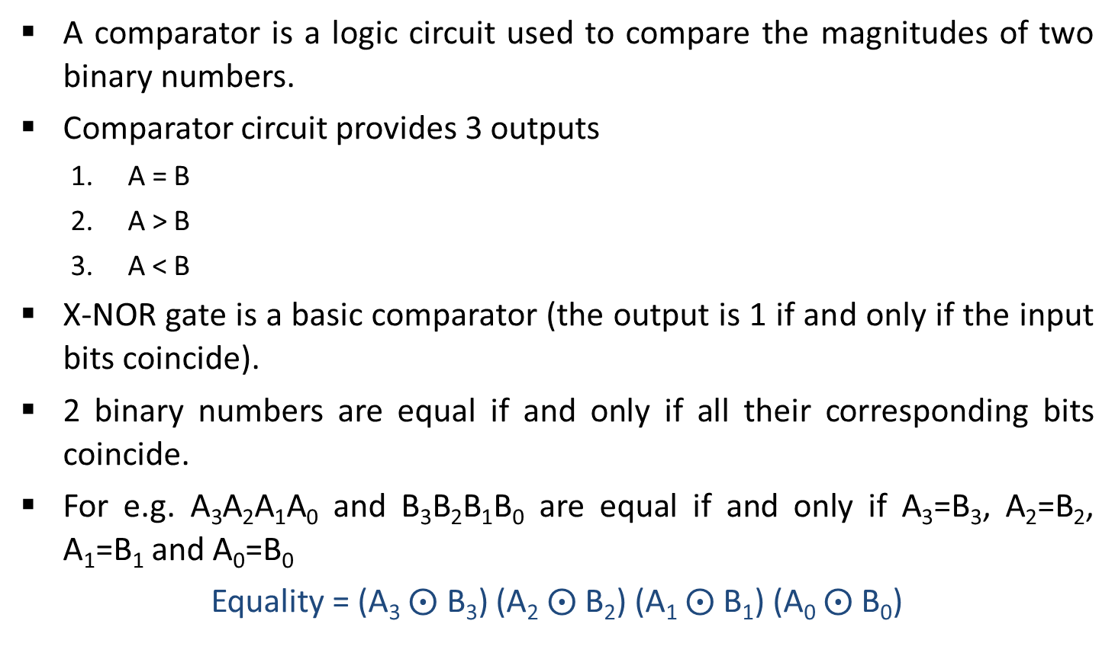
Comparators
A comparator is a logic circuit used to compare the magnitudes of two binary numbers.
Comparator circuit provides 3 outputs
A = B
A > B
A < B
X-NOR gate is a basic comparator (the output is 1 if and only if the input bits coincide).
2 binary numbers are equal if and only if all their corresponding bits coincide.
For e.g. A₃A₂A₁A₀ and B₃B₂B₁B₀ are equal if and only if A₃=B₃, A₂=B₂, A₁=B₁ and A₀=B₀
Equality = (A₃$⨀$ B₃) (A₂$⨀$B₂) (A₁$⨀$B₁) (A₀$⨀$B₀)

Slide 70

1-bit Magnitude Comparator
Let the 1-bit numbers be A = A₀ and B = B₀
If A₀ = 1 and B₀ = 0 then A > B
A > B : G = A₀B₀’
If A₀ = 0 and B₀ = 1 then A <B
A < B : L = A₀’B₀
If A₀ = 1 and B₀ = 1 (coincides) then A = B
A = B : E = A₀ $⨀$B₀

Slide 71
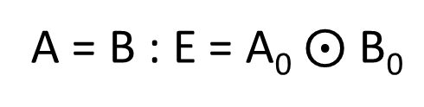
1-bit Magnitude Comparator
Truth table and logic diagram are as follows
A₀ | B₀ | L | E | G
0 | 0 | 0 | 1 | 0
0 | 1 | 1 | 0 | 0
1 | 0 | 0 | 0 | 1
1 | 1 | 0 | 1 | 0
A < B(L)
A₀
B₀
A = B(E)
A < B : L = A₀’B₀
A = B : E = A₀$⨀$B₀
A > B(G)
A > B : G = A₀B₀’

Slide 72
2-bit Magnitude Comparator
Let the two 2-bit numbers be A = A₁A₀ and B = B₁B₀
If A₁ = 1 and B₁ = 0, then A > B or
If A₁ and B₁ coincide and A₀ = 1 and B₀ = 0, then A > B.
A > B : G = A₁B₁’ + (A₁ ⊙ B₁) A₀B₀’
If A₁ = 0 and B₁ = 1, then A < B or
If A₁ and B₁ coincide and A₀ = 0 and B₀ = 1, then A < B.
A < B : L = A₁’B₁ + (A₁ ⊙ B₁) A₀’B₀
If A₁ and B₁ coincide and if A₀ and B₀ coincide then A = B.
A = B : E = (A₁ ⊙ B₁)(A₀ ⊙ B₀)

Slide 73
2-bit Magnitude Comparator
Logic diagram for a 2-bit comparator is as follows
A₁
B₁’
A₀
A > B(G)
B₀’
A₁
B₁
A = B(E)
A₀
B₀
A₀’
B₀
A < B(L)
A₁’
B₁

Slide 74
Parity Generator
Binary data, when transmitted and processed is susceptible to noise that can alter its 1s to 0s and 0s to 1s.
To detect such errors, an additional bit called parity bit is added to the data bits and the word containing the data bits and the parity bit is transmitted.
At the receiving end the number of 1s in the word received are counted and the error, if any, is detected.
Even Parity
Odd Parity
0 | 0 | 1 | 1
0 | 0 | 1 | 0
Data
Parity bit
Data
Parity bit

Slide 75
3-bit parity generator using even parity bit
Let the 3-bit input be A, B and C.
For even parity, a parity bit 1 is added such that the total number of 1s in the 3-bit input and parity bit together is even.

Slide 76







3-bit parity generator using even parity bit
Truth Table
K - Map
Inputs |  |  | Outputs parity bit (f)
A | B | C
0 | 0 | 0 | 0
0 | 0 | 1 | 1
0 | 1 | 0 | 1
0 | 1 | 1 | 0
1 | 0 | 0 | 1
1 | 0 | 1 | 0
1 | 1 | 0 | 0
1 | 1 | 1 | 1
AB
00
01
11
10
C
0
1
1
1
1
1
$$f=A^{′}B^{′}C$$
$$+ A^{′}BC′$$
$$+ ABC$$
$$+ AB′C′$$
$$f=A^{′}\left(B^{′}C+BC^{′}\right)+A(BC+B^{′}C^{′})$$
$$f=A^{′}\left(B ⨁ C\right)+A\left(B ⨁ C\right)′$$
$$f=A ⊕B ⨁ C$$

Slide 77

3-bit parity generator using even parity bit
$$f=A ⊕B ⨁ C$$
Logic Diagram
A
B
f
C

Slide 78
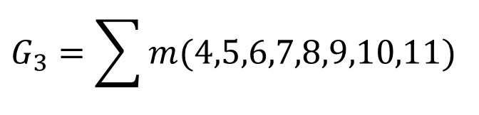
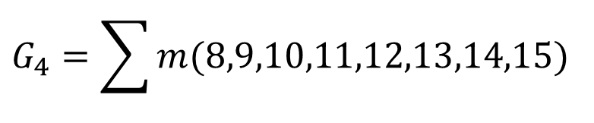
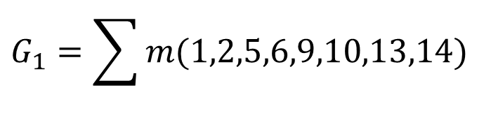
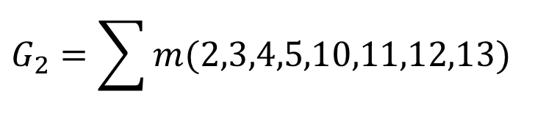
Binary to Gray Code Converter
4-bit Binary |  |  |  | 4-bit Gray
B₄ | B₃ | B₂ | B₁ | G₄ | G₃ | G₂ | G₁
0 | 0 | 0 | 0 | 0 | 0 | 0 | 0
0 | 0 | 0 | 1 | 0 | 0 | 0 | 1
0 | 0 | 1 | 0 | 0 | 0 | 1 | 1
0 | 0 | 1 | 1 | 0 | 0 | 1 | 0
0 | 1 | 0 | 0 | 0 | 1 | 1 | 0
0 | 1 | 0 | 1 | 0 | 1 | 1 | 1
0 | 1 | 1 | 0 | 0 | 1 | 0 | 1
0 | 1 | 1 | 1 | 0 | 1 | 0 | 0
1 | 0 | 0 | 0 | 1 | 1 | 0 | 0
1 | 0 | 0 | 1 | 1 | 1 | 0 | 1
1 | 0 | 1 | 0 | 1 | 1 | 1 | 1
1 | 0 | 1 | 1 | 1 | 1 | 1 | 0
1 | 1 | 0 | 0 | 1 | 0 | 1 | 0
1 | 1 | 0 | 1 | 1 | 0 | 1 | 1
1 | 1 | 1 | 0 | 1 | 0 | 0 | 1
1 | 1 | 1 | 1 | 1 | 0 | 0 | 0
$$G_{4}=\sum{m(8,9,10,11,12,13,14,15)}$$
$$G_{3}=\sum{m(4,5,6,7,8,9,10,11)}$$
$$G_{2}=\sum{m(2,3,4,5,10,11,12,13)}$$
$$G_{1}=\sum{m(1,2,5,6,9,10,13,14)}$$

Slide 79
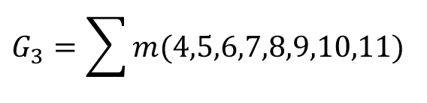
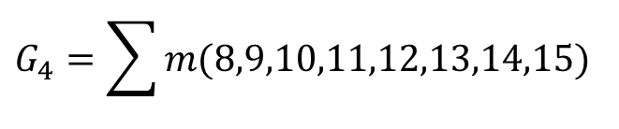
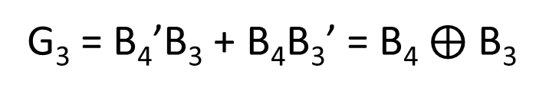
Binary to Gray Code Converter
K-Map for G₄, G₃, G₂, G₁ function and their minimization are as follows:
$$G_{4}=\sum{m(8,9,10,11,12,13,14,15)}$$
$$G_{3}=\sum{m(4,5,6,7,8,9,10,11)}$$
B₄B₃
B₄B₃
00
01
11
10
00
01
11
10
B₂B₁
B₂B₁
0
4
12
8
0
4
12
8
00
1
1
00
1
1
1
5
13
9
1
5
13
9
01
1
1
01
1
1
3
7
15
11
3
7
15
11
11
1
1
11
1
1
2
6
14
10
2
6
14
10
10
1
1
10
1
1
G₄ = B₄
G₃ = B₄’B₃ + B₄B₃’ = B₄$⨁$ B₃

Slide 80
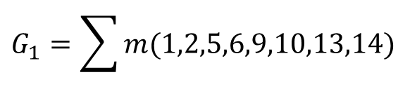
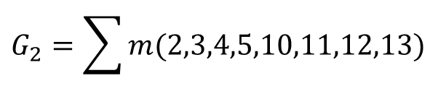
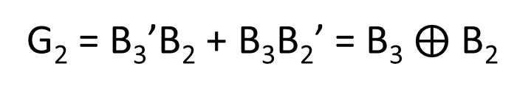
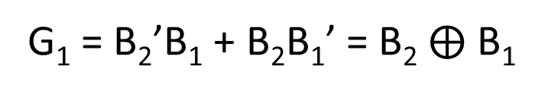
Binary to Gray Code Converter
$$G_{2}=\sum{m(2,3,4,5,10,11,12,13)}$$
$$G_{1}=\sum{m(1,2,5,6,9,10,13,14)}$$
B₄B₃
B₄B₃
00
01
11
10
00
01
11
10
B₂B₁
B₂B₁
0
4
12
8
0
4
12
8
00
1
1
00
1
5
13
9
1
5
13
9
01
1
1
01
1
1
1
1
3
7
15
11
3
7
15
11
11
1
1
11
2
6
14
10
2
6
14
10
10
1
1
10
1
1
1
1
G₂ = B₃’B₂ + B₃B₂’ = B₃$⨁$ B₂
G₁ = B₂’B₁ + B₂B₁’ = B₂$⨁$ B₁

Slide 81
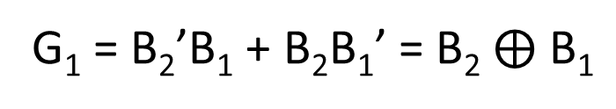
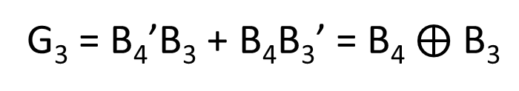
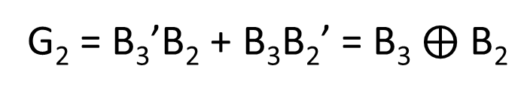
Binary to Gray Code Converter
Logic diagram for binary to Gray code converter is as follows:
G₄ = B₄
B₄
G₄
G₃ = B₄’B₃ + B₄B₃’ = B₄$⨁$ B₃
G₃
B₃
G₂ = B₃’B₂ + B₃B₂’ = B₃$⨁$ B₂
G₁ = B₂’B₁ + B₂B₁’ = B₂$⨁$ B₁
G₂
B₂
G₁
B₁

Slide 82
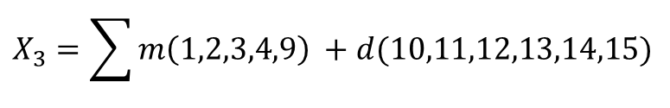
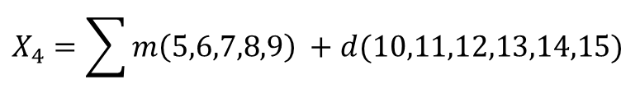
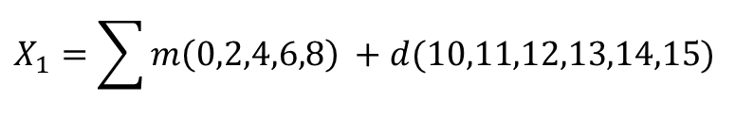
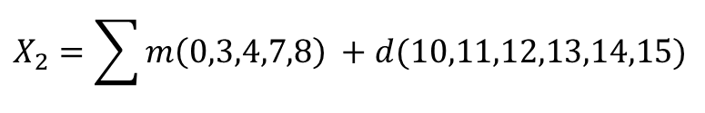
BCD to Excess-3 Code Converter
8421 BCD |  |  |  | XS - 3
B₄ | B₃ | B₂ | B₁ | X₄ | X₃ | X₂ | X₁
0 | 0 | 0 | 0 | 0 | 0 | 1 | 1
0 | 0 | 0 | 1 | 0 | 1 | 0 | 0
0 | 0 | 1 | 0 | 0 | 1 | 0 | 1
0 | 0 | 1 | 1 | 0 | 1 | 1 | 0
0 | 1 | 0 | 0 | 0 | 1 | 1 | 1
0 | 1 | 0 | 1 | 1 | 0 | 0 | 0
0 | 1 | 1 | 0 | 1 | 0 | 0 | 1
0 | 1 | 1 | 1 | 1 | 0 | 1 | 0
1 | 0 | 0 | 0 | 1 | 0 | 1 | 1
1 | 0 | 0 | 1 | 1 | 1 | 0 | 0
$$X_{4}=\sum{m\left(5,6,7,8,9\right)} +d(10,11,12,13,14,15)$$
$$X_{3}=\sum{m\left(1,2,3,4,9\right)} +d(10,11,12,13,14,15)$$
$$X_{2}=\sum{m\left(0,3,4,7,8\right)} +d(10,11,12,13,14,15)$$
$$X_{1}=\sum{m\left(0,2,4,6,8\right)} +d(10,11,12,13,14,15)$$

Slide 83
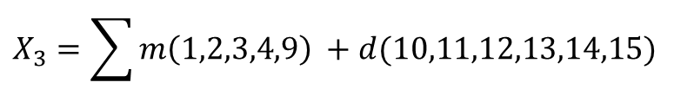
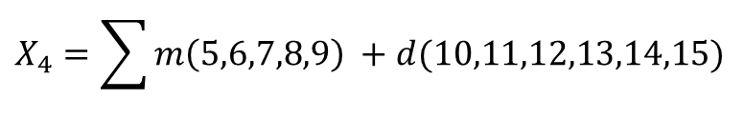
BCD to Excess-3 Code Converter
K-Map for X₄, X₃, X₂, X₁ function and their minimization are as follows:
$$X_{4}=\sum{m\left(5,6,7,8,9\right)} +d(10,11,12,13,14,15)$$
$$X_{3}=\sum{m\left(1,2,3,4,9\right)} +d(10,11,12,13,14,15)$$
B₄B₃
B₄B₃
00
01
11
10
B₂B₁
00
01
11
10
B₂B₁
0
4
12
8
0
4
12
8
00
x
1
00
1
x
1
5
13
9
1
5
13
9
01
1
x
1
01
1
x
1
3
7
15
11
3
7
15
11
11
1
x
x
11
1
x
x
2
6
14
10
2
6
14
10
10
1
x
x
10
1
x
x
X₄ = B₄ + B₃B₂ + B₃B₁
X₃ = B₃B₂’B₁’ + B₃’ B₁ + B₃’ B₂

Slide 84
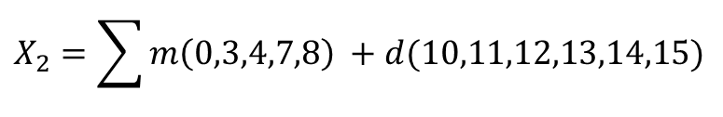
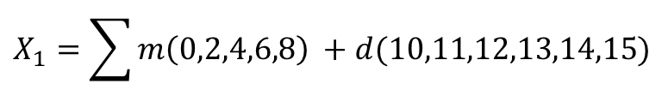
BCD to Excess-3 Code Converter
$$X_{2}=\sum{m\left(0,3,4,7,8\right)} +d(10,11,12,13,14,15)$$
$$X_{1}=\sum{m\left(0,2,4,6,8\right)} +d(10,11,12,13,14,15)$$
B₄B₃
B₄B₃
00
01
11
10
B₂B₁
00
01
11
10
B₂B₁
0
4
12
8
0
4
12
8
00
1
1
x
1
00
1
1
x
1
1
5
13
9
1
5
13
9
01
x
01
x
3
7
15
11
3
7
15
11
11
1
1
x
x
11
x
x
2
6
14
10
2
6
14
10
10
x
x
10
1
1
x
x
X₂ = B₂’B₁’ + B₂B₁
X₁ = B₁’

Slide 85
BCD to Excess-3 Code Converter
Logic diagram for a BCD to Excess-3 is as follows
B₄
B₃
B₂
X₄
B₃
B₁
B₃
B₂’
B₁’
B₃’
B₁
X₃
B₃’
B₂
B₂’
B₁’
X₂
B₂
B₁
B₁’
X₁

Slide 86
Code Converters Exercise
Binary to BCD converter
BCD to Gray code converter

Slide 87
Encoder
Device to convert familiar numbers or symbols into coded format.
It has a number of input lines, only one of which is activated at a given time, and produces an N-bit output code depending on which input is activated.
Figure shows the block diagram of an encoder with M inputs and N outputs.
I₀
O₀
I₁
O₁
I₂
O₂
.
.
.
.
.
.
M inputs
Encoder
N outputs
I_{M-2}
O_{N-2}
I_{M-1}
O_{N-1}
M = 2^{N}

Slide 88
Priority Encoder
A priority encoder is a logic circuit that responds to just one input in accordance with some priority system, among all those that may be simultaneously HIGH.
The most common priority system is based on the relative magnitudes of the inputs; whichever decimal input is the largest, is the one that is encoded.
For example, if both decimal 3 and decimal 4 are activated simultaneously, then a priority encoder would encode decimal 4.

Slide 89



Priority Encoder
Truth Table
Inputs |  |  |  | Outputs
D₀ | D₁ | D₂ | D₃ | A | B | V
0 | 0 | 0 | 0 | x | x | 0
1 | 0 | 0 | 0 | 0 | 0 | 1
x | 1 | 0 | 0 | 0 | 1 | 1
x | x | 1 | 0 | 1 | 0 | 1
x | x | x | 1 | 1 | 1 | 1
$$A= \sum_{m}{(1, 2, 3, 5, 6, 7, 9, 10, 11, 13, 14, 15)}$$
$$B= \sum_{m}{(1, 3, 4, 5, 7, 9, 11, 12, 13, 15)}$$
$$V= \sum_{m}{(1, 2, 3, 4, 5, 6, 7, 8, 9, 10, 11, 12, 13, 14, 15)}$$

Slide 90


Priority Encoder
$$A= \sum_{m}{(1, 2, 3, 5, 6, 7, 9, 10, 11, 13, 14, 15)}$$
$$B= \sum_{m}{(1, 3, 4, 5, 7, 9, 11, 12, 13, 15)}$$
D₀D₁
D₀D₁
00
01
11
10
00
01
11
10
D₂D₃
D₂D₃
0
4
12
8
0
4
12
8
00
x
00
x
1
1
1
5
13
9
1
5
13
9
01
1
1
1
1
01
1
1
1
1
3
7
15
11
3
7
15
11
11
1
1
1
1
11
1
1
1
1
2
6
14
10
2
6
14
10
10
1
1
1
1
10
A = D₃ + D₂
B = D₃ + D₂’ D₁

Slide 91

Priority Encoder
$$V= \sum_{m}{(1, 2, 3, 4, 5, 6, 7, 8, 9, 10, 11, 12, 13, 14, 15)}$$
D₀D₁
00
01
11
10
D₂D₃
0
4
12
8
00
0
1
1
1
1
5
13
9
01
1
1
1
1
3
7
15
11
11
1
1
1
1
2
6
14
10
10
1
1
1
1
V = D₃ + D₂ + D₁ + D₀

Slide 92
Priority Encoder
D₃
B = D₃ + D₂’ D₁
D₂
D₁
A = D₃ + D₂
V = D₃ + D₂ + D₁ + D₀
D₀

Slide 93
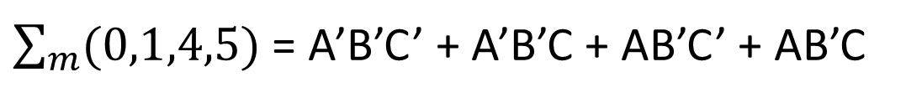

Tabulation Method (Quine McCluskey Method)
Fundamental idea for tabulation method is combining theorem.
$$PA+PA^{′}=P$$
The above theorem is applied repeatedly to all adjacent pairs of terms which results in prime implicants.
Consider the minimization of the expression
$\sum_{m}{(0,1,4,5)}$ = A’B’C’ + A’B’C + AB’C’ + AB’C
= A’B’(C + C’) + AB’(C + C’)
= A’B’ + AB’
= B’(A + A’)
= B’

Slide 94
Procedure for minimization using Tabulation Method
List all the minterms.
Arrange all minterms in groups of the same number of 1s in their binary representation in column 1. Start with the least number of 1s group and continue with groups of increasing number of 1s.
Compare each term of the lowest index group with every term in the succeeding group. Whenever possible, combine the two terms being compared by means of the combining theorem. Two terms from adjacent groups are combinable, if their binary representations differ by just a single digit in the same position; the combined terms consist of the original fixed representation with the differing one replaced by a dash (-). Place a check mark (√) next to every term, which has been combined with at least one term and write the combined terms in column 2. Repeat this by comparing each term in a group of index i with every term in the group of index i + 1, until all possible applications of the combining theorem have been exhausted.

Slide 95
Procedure for minimization using Tabulation Method
Compare the terms generated in step 3 in the same fashion; combine two terms which differ by only a single 1 and whose dashes are in the same position to generate a new term. Two terms with dashes in different positions cannot be combined. Write the new terms in column 3 and put a check mark next to each term which has been combined in column 2. Continue the process with terms in columns 3, 4 etc. until no further combinations are possible. The remaining unchecked terms constitute the set of prime implicants of the expression.
List all the prime implicants and draw the prime implicant chart. (The don’t cares if any should not appear in the prime implicant chart).
Obtain the essential prime implicants and write the minimal expression.

Slide 96
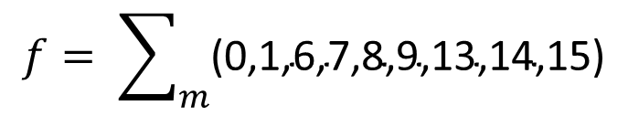
Tabulation Method of Reduction
Consider function
$$f= \sum_{m}{\text{(0,1,6,7,8,9,13,14,15)}}$$
Step – 1: List all minterms
Minterms | Binary Designation
0 | 0 0 0 0
1 | 0 0 0 1
6 | 0 1 1 0
7 | 0 1 1 1
8 | 1 0 0 0
9 | 1 0 0 1
13 | 1 1 0 1
14 | 1 1 1 0
15 | 1 1 1 1

Slide 97
Tabulation Method of Reduction
Step – 2: Arrange all minterms in groups of same number of 1s
Column 1
Index | Minterms | Binary Designation
Index 0 | 0 | 0 0 0 0
Index 1 | 1 8 | 0 0 0 1 1 0 0 0
Index 2 | 6 9 | 0 1 1 0 1 0 0 1
Index 3 | 7 13 14 | 0 1 1 1 1 1 0 1 1 1 1 0
Index 4 | 15 | 1 1 1 1

Slide 98
Tabulation Method of Reduction
Step – 3: Compare each term of the lowest index group with every term in the succeeding group till no change
Column 1
Index | Minterms | Binary Designation
Index 0 | 0 | 0 0 0 0
Index 1 | 1 8 | 0 0 0 1 1 0 0 0
Index 2 | 6 9 | 0 1 1 0 1 0 0 1
Index 3 | 7 13 14 | 0 1 1 1 1 1 0 1 1 1 1 0
Index 4 | 15 | 1 1 1 1
Column 2
Pairs | A B C D
0, 1 0, 8 | 0 0 0 _ _ 0 0 0
1, 9 8, 9 | _ 0 0 1 1 0 0 _
6, 7 6, 14 9,13 | 0 1 1 _ _ 1 1 0 1 _ 0 1
7, 15 13, 15 14, 15 | _ 1 1 1 1 1 _ 1 1 1 1 _
√
√
√
√
√
√
√
√
√

Slide 99
Tabulation Method of Reduction
Step – 4: Compare the terms generated in step 3 in the same fashion until no further combinations are possible
Pairs | A B C D
0, 1 0, 8 | 0 0 0 _ _ 0 0 0
1, 9 8, 9 | _ 0 0 1 1 0 0 _
6, 7 6, 14 9,13 | 0 1 1 _ _ 1 1 0 1 _ 0 1
7, 15 13, 15 14, 15 | _ 1 1 1 1 1 _ 1 1 1 1 _
Quads | A B C D
0, 1, 8, 9 | _ 0 0 _
--- | ---
6, 7, 14, 15 | _ 1 1 _
√
Q
√
√
P
√
√
√
S
√
R
√

Slide 100
Tabulation Method of Reduction
Step – 5: List all prime implicants and draw prime implicants chart
Prime Implicants : P(BC), Q(B’C’), R(ABD), S(AC’D)
 | √ | √ | √ | √ | √ | √ |  | √ | √
PIs | 0 | 1 | 6 | 7 | 8 | 9 | 13 | 14 | 15
P (6,7,14,15) |  |  | x | x |  |  |  | x | x
Q (0,1,8,9) | x | x |  |  | x | x
R (13,15) |  |  |  |  |  |  | x |  | x
S (9,13) |  |  |  |  |  | x | x
Step – 6: Obtain essential prime implicants and minimal expression
Essential Prime Implicants : P(BC)
, Q(B’C’)
As minterm 13 is covered by R and S
Minimal expression : P + Q + R = BC + B’C’ + ABD
OR P + Q + S = BC + B’C’ + AC’D

Slide 101
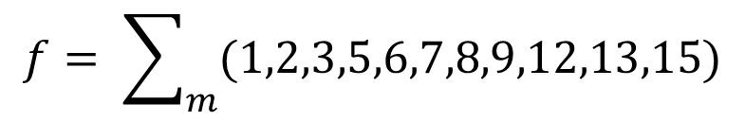


Exercise
Reduce the function to simplest form using tabulation method
$$f= \sum_{m}{(1,2,3,5,6,7,8,9,12,13,15)}$$
$$BD+AC^{′}+A^{′}C+C^{′}D$$
$$BD+AC^{′}+A^{′}C+A^{′}D$$

